Slide 1

Book Shop
A Internship Project
On
Represented By,
Vishal Borase

Slide 2
Introduction
This is my portfolio project which demonstrates with my abilities in building a completely based on JDBC i.e Java Database Connectivity. i Created Database Connection between Java Eclipse Code and Mysql . Create a Database i.e the Namely as “Book-Shop” In. these Database User stores Many No of Books information i.e Book name its Edition and its Price He Display all of that Data with List. And Also Make Many Operations On it He can Save Book Data , Update the Book Data , Delete the Book Data and Clear the Book Data .

Slide 3
JDBC
What is JDBC ?
JDBC stands for Java Database Connectivity. JDBC is a Java API to connect and execute the query with the database. It is a part of JavaSE (Java Standard Edition). JDBC API uses JDBC drivers to connect with the database.
We can use JDBC API to access tabular data stored in any relational database. By the help of JDBC API, we can save, update, delete and fetch data from the database. What is API ? API (Application programming interface) is a programs document that contains a description of all the features of a product or software. It represents classes and interfaces that software can follow to communicate with each other. An API can be created for applications, libraries, operating systems, etc.
There are 4 types of Driver Softwares:
Type1 Driver : JDBC-ODBC Bridge
Type2 Driver : Native API Driver
Type3 Driver : Network Protocol Driver
Type4 Driver : Pure Java Driver/ Thin Driver

Slide 4
When we are interacting with the database we must following the following steps:
1. load the driver
mysql 8.O → Class.forName("com.mysql.cj.jdbc.Driver");//adding the jar
2. establish connection
DriverManager.getConnection(url,user,pwd);
url = jdbc:mysql://localhost:3306/bookshop?autoReconnect=true&useSSL=false
jdbc → API
mysql → database
localhost → Network
3306 → Port for mysql
jdbc_training → database name
name = root
pwd = root
3. prepare the query
4. run the query and get the results
5. close all the open connections

Slide 5
Software Tools
Java Eclipse IDE
Mysql
Windows Builder
Mysql Connector jar
rs2xml.jar
Xampp

Slide 6
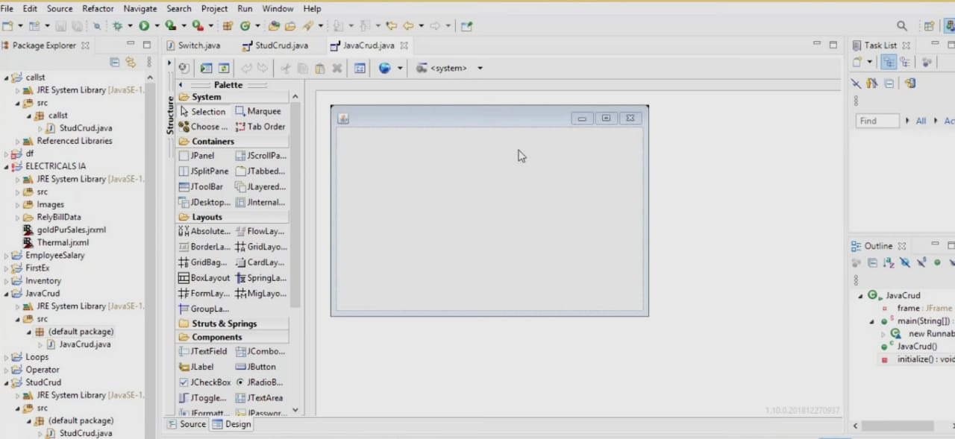
Steps For Create the Project :
Firstly, Create New Java Project File and Give name as JavaCrud then Creat class name JavaCrud.java .
Download Windows builder Using Eclipse Marketplace and then Going to Design Application Windows For Our project file that is steps , Firstly Right Click on project → New → Others → Windows Builder → Swing Designer → Application Window . This Application Window Shows below pic then Resize it.

Slide 7
Design Application Window :-
From the Using Palette i.e Left Side Palette from application window There are many tools We want to used in our project Design that are Section wise i.e System, Containers, Layouts, Struct & Springs , Components etc.
From The Palette Firstly Going to Components , Select and Drag JLabel as New Label for our Application window and Going to properties Change the Name Or Rename as a “Book Shop” and Using Properties also change Font and Bold it.
Then , We Need to Design Registeration Panel For that Select and Drag JPanel from Containers Going to properties of the panel then select border then Select TitledBorder Give Title as Registeration. In Registeration Panel Using Jlabel Create Three Labels Rename it as Book Name , Edition , Price then Drag JTextField For all of these in front of each labels and Design Registeration Panel. And Also Rename JTextField name as txtbname , txtedition and txtprice .
After that We need to Create Buttons Save , Exit , Clear is in below the Registeration Panel For that Select and Drag JButton From Components Rename it From Properties as Save , Exit and Clear

Slide 8
Design Search Panel Select and Drag JPanel from Containers Going to properties of the panel then select border then Select TitledBorder Give Title as Search.
After that Select and Design Scroll Pane in Application Windows i.e Right Side of Registeration Panel Go to pallete Select and DragJScrollPane From Containers.
Finally Design Update and Delete Buttons Select and Drag JButton From Components Rename it From Properties as Update and Delete .

Slide 9
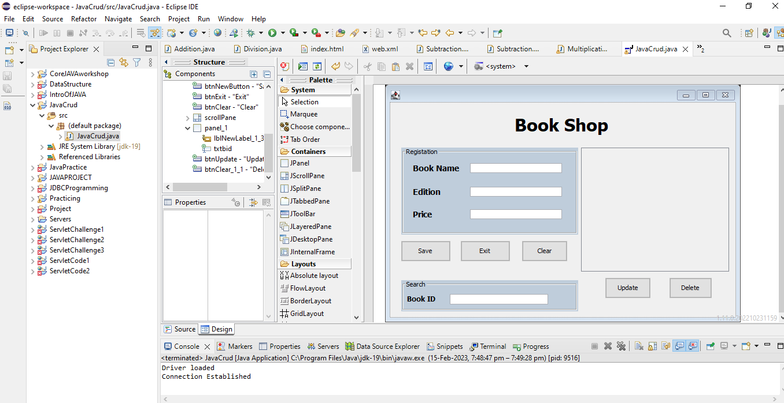
Application Windows Design

Slide 10
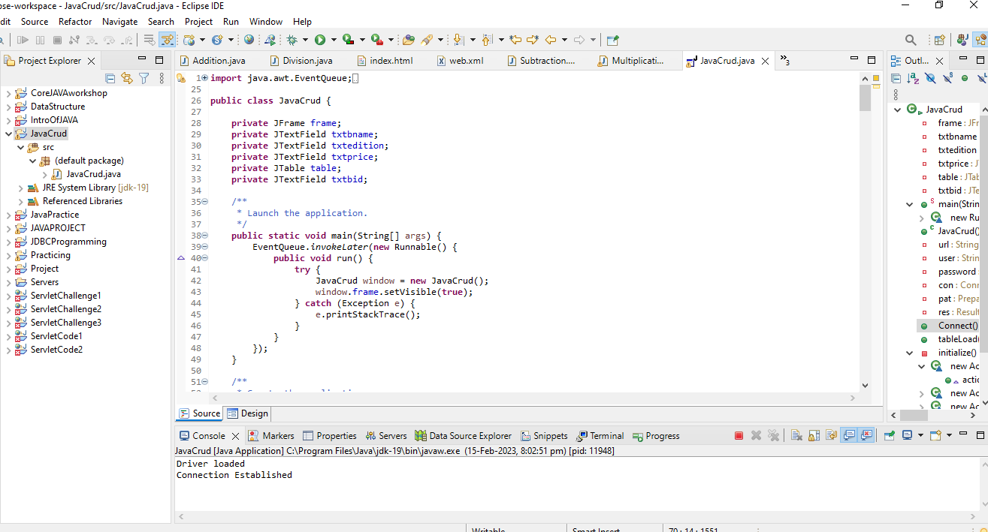
JDBC JavaCrud Source Code

Slide 11
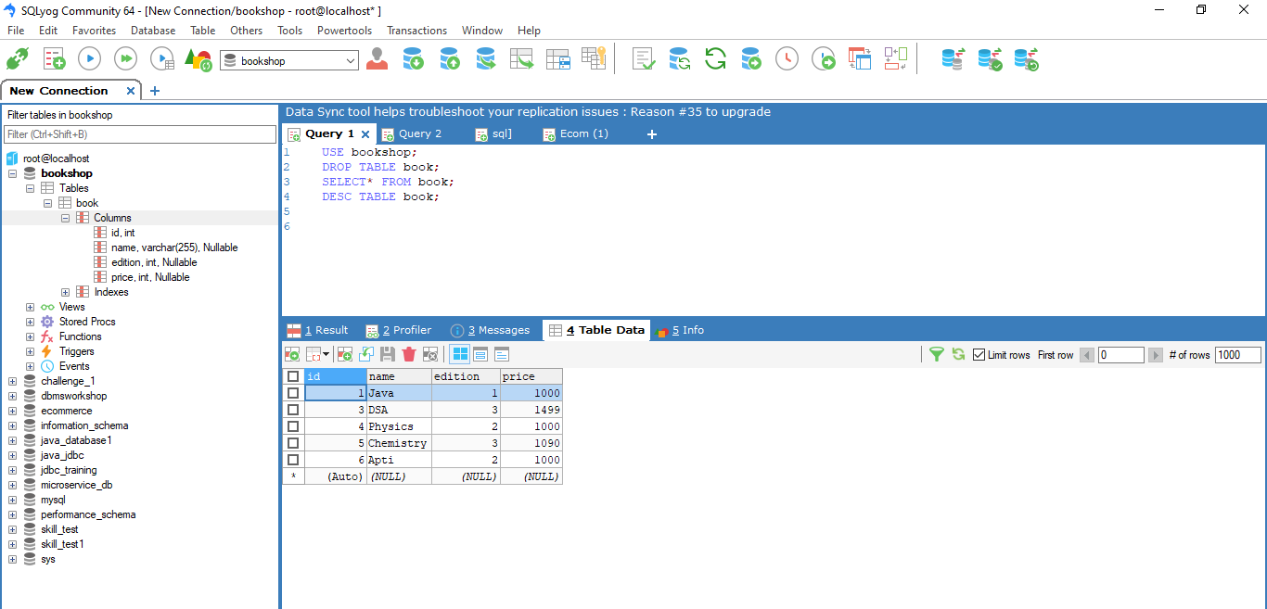
MySQLyog Windows

Slide 12
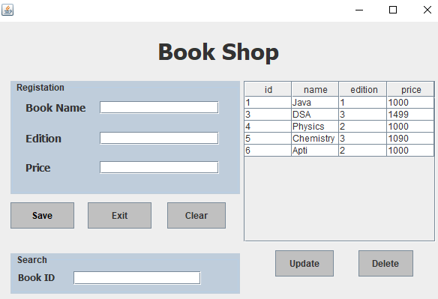
Output Windows

Slide 13
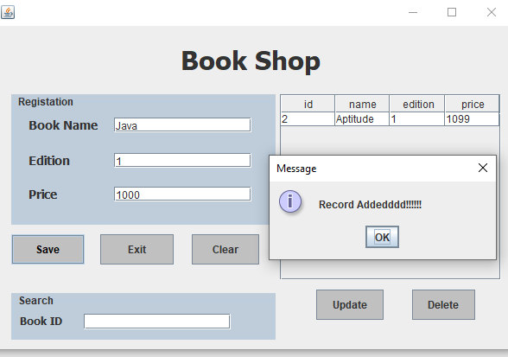
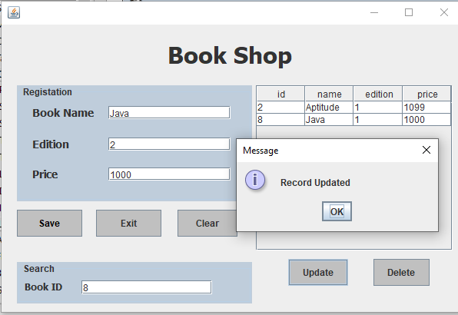
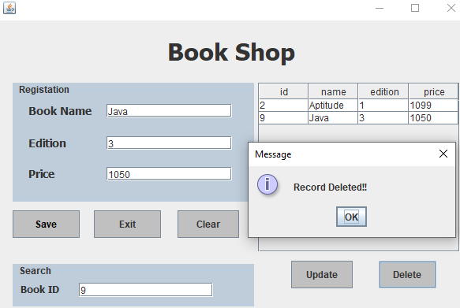
JDBC Operations
Record Added
Record Updated
Record Deleted

Slide 14
conclusion
In this project I learnt about crud operations using Window Builder GUI for user interaction and it was easy to develop code There are Many tools From the Using Windows builder which helps create project and that is automatically generates the partial code.

Slide 15
Thank you ……..

